Slide 1
Modulating Rubisco subunits through gene overexpression to maximise photosynthetic efficiency:
CHEME-7770 05/05/2022
Shripathi Ramakrishnan,
Smith School of Chemical and Biomolecular Engineering
Cornell University, Ithaca, New York
Notes:
Good evening, I am Shripathi, and this is my presentation on modulating Rubisco subunits through gene overexpression to maximise photosynthetic efficiency.

Slide 2
Table of Contents:
Introduction
1. Overview of photosynthesis
2. Key bottlenecks in C4 plants
Modelling C4 photosynthesis
3. Transgenic approach
4. The proposed model
5. Formulation of the problem
6. Moving forward
Notes:
In this presentation, I will give a brief overview of photosynthetic pathways, key bottlenecks in C4 plants, the proposed approach and model to improve photosynthetic yields and how I formulated the problem.

Slide 3
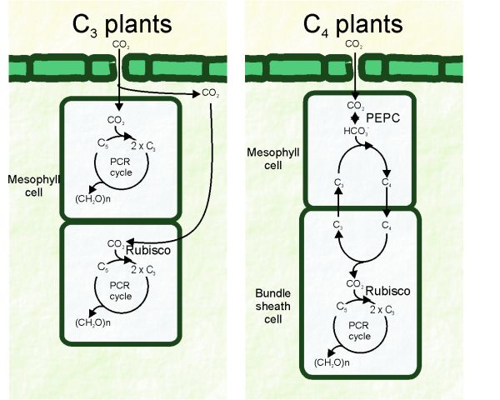
Overview of Photosynthesis
Rubisco catalyses two competing reactions: carboxylation and oxygenation.
C3: Higher oxygen partial pressure drives photorespiration pathway as opposed to PCR, reducing crop yield.
C4: Carbon concentrating mechanism: CO₂ converted into intermediate C4 which is decarboxylated in O₂ impermeable bundlesheath.
Lara, M. V. , & Andreo, C. S. (2011). C4 Plants Adaptation to High Levels of CO2 and to Drought Environments. In A. Shanker, & B. Venkateswarlu (Eds.), Abiotic Stress in Plants - Mechanisms and Adaptations. IntechOpen. https://doi.org/10.5772/24936
Notes:
The increasing global demands for food supply and bioenergy have placed a high need on improving agricultural yield. It is now widely recognised that improving carbon fixation of photosynthetic plants can achieve this. Broadly, plants may be classified into C3 and C4 plants depending on photosynthetic pathways. C3 plants undergo carbon fixation by absorbing CO2 in the mesophyll present in the leaf's chloroplast organelle, where CO2 converted to 3 carbon carboxylic acid catalysed by rubisco, which is the most abundant enzyme on the planet. However, rubisco simultaneously catalyses....
Therefore, the high O2 partial pressures drives oxygenation/photorespiration....
C4 plants circumvent this with a carbon concentrating mechanism, where they convert CO2 into tetracarboxylic acid, which is decarboxylated into CO2 and tricarb in the bundle sheath. This causes a high partial pressure of CO2 in the semipermeable bundle sheath, promoting carboxylation and reducing photorespiration. Thus, C4 plants stand better to accomodate the worlds agricultural needs.

Slide 4
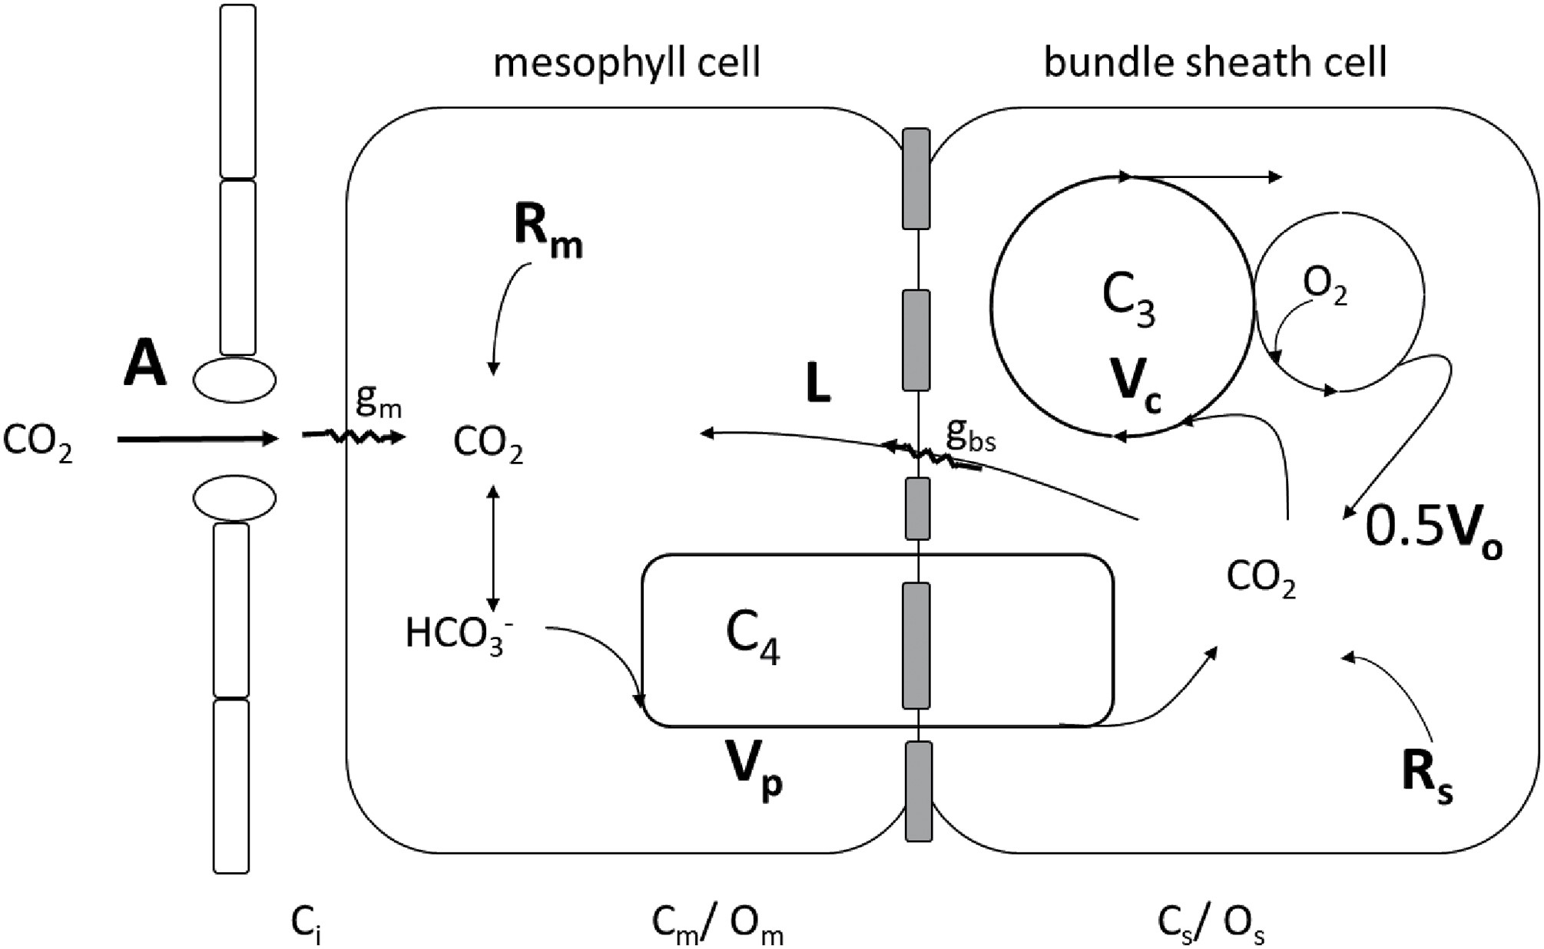
Key Bottleneck in C4 Plants
Intrisically low K_{cat} of Rubisco (c.a. 3 s⁻¹);
CO₂ flux leakage from bundle-sheath;
Low N₂ availability
Susanne von Caemmerer, Updating the steady-state model of C₄ photosynthesis, Journal of Experimental Botany, Volume 72, Issue 17, 2 September 2021, Pages 6003–6017, https://doi.org/10.1093/jxb/erab266
Notes:
Having said that, there is indeed room for improvement. Firstly, the carbon fixation reaction is inherently slow, due the slow catalytic rate of Rubisco enzyme. Further, the rate of conversion of C4 to CO2 is much quicker than CO2 fixation, causing the unfixed CO2 to leak back into the mesophyll and be wasted. Lastly, the high partial pressure of CO2 entails poorer absorption of other essential gases such as nitrogen, which are critical to suppressing the oxygenation reaction.

Slide 5
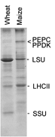
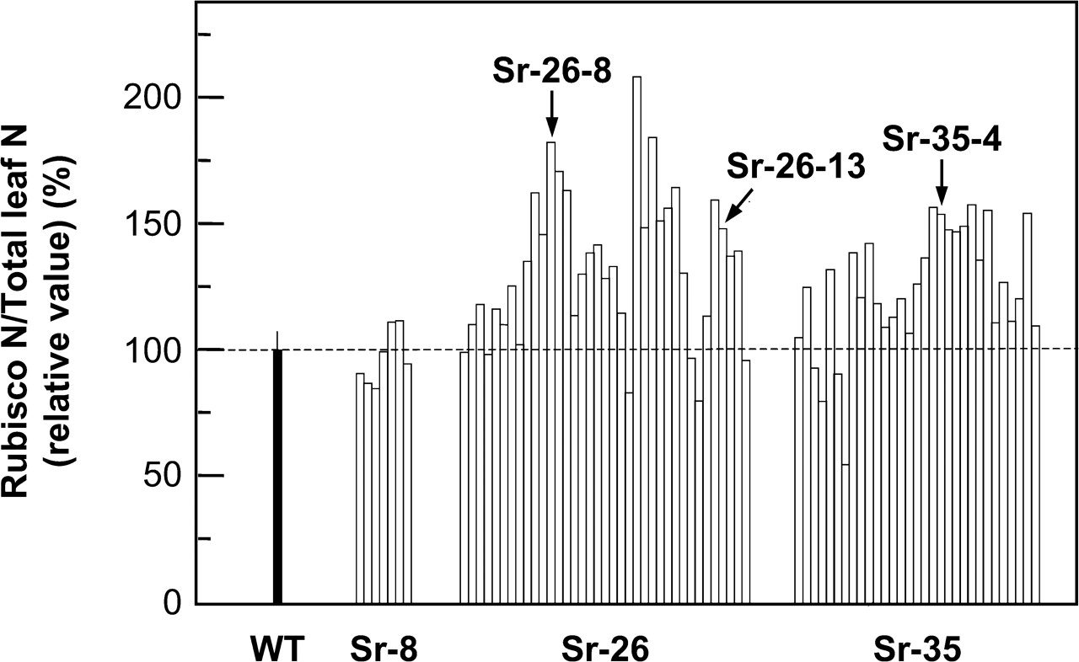
Proposed Solution: Transgenic Approach
Rubisco synthesis encoded by 2 genes: RBCS (8 small subunits)
rbcL (8 large subunits)
Overexpression of RBCS increased Rubisco content by 30% in transgenic rice (C3).
Enzymatic activity as a function of Rubisco conc clearly increases.
Motivation: Will improved Rubisco content and more efficient carbon-fixation yield better photosynthetic rates?
Yuji Suzuki, Maki Ohkubo, Hanako Hatakeyama, Keiko Ohashi, Ryuichi Yoshizawa, Soichi Kojima, Toshihiko Hayakawa, Tomoyuki Yamaya, Tadahiko Mae, Amane Makino, Increased Rubisco Content in Transgenic Rice Transformed with the ‘Sense’ rbcS Gene, Plant and Cell Physiology, Volume 48, Issue 4, April 2007, Pages 626–637, https://doi.org/10.1093/pcp/pcm035
Notes:
Recent efforts for improving photosynthetic yields have focussed on increasing the catalytic rate of decarboxylation by simply increasing the Rubisco content. So how is it possible to engineer the Rubisco concentration per leaf? Well, Rubisco synthesis is encoded by two primary genes, RBCS and RBCL. RBCS is composed of 8....and rbcL is.....As rbcl is a larger subunit, the rate of translation to produce Rubisco is slower. We can increase the overall transcription rate by overexpressing RBCS. A reference here shows that RBCS overexpression has successfully improved the Rub content by 30%. However, these approaches are limited to transgenic C3 plants. As their CO2 fixation is not very efficient, they are not well placed to take advantage of this improvement. The reference shows no overall improvement in CO2 assimilation, as a result. This gives rise to my main motivation, will improved rubisco content and more eff……

Slide 6
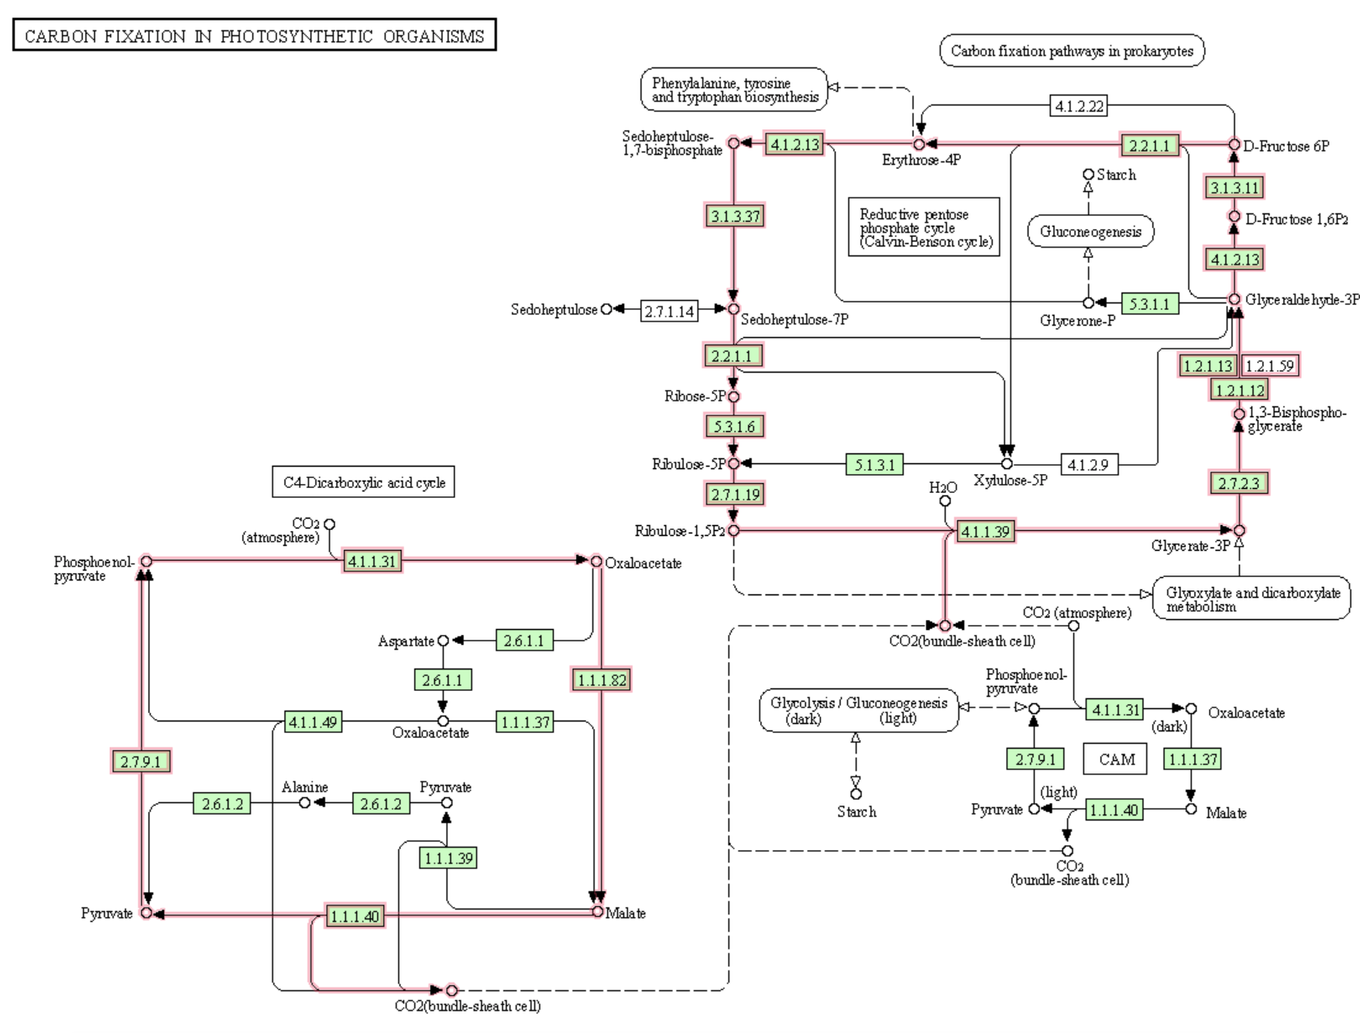
The Proposed Model
A model with 36 metabolites and 35 reactions
Composed of two distinct processes: Tetradicarboxylic acid pathway and pentose-phosphate cycle;
Flux balance analysis: max (w_{X} = θ^{T}_{w}) subject to: Sw = 0
L_{i} ≤ w_{i} ≤ U_{i} i=1,2,...,
Assumptions:
End product of photosynthesis: Biomass (Glyceraldehyde-3P)
Assuming Rubisco-limited reaction;
Not accounting for membrane/diffusion-limited gas-exchange;
Points of interest:
Carboxylation/oxygenation rates of reaction (especially post-overexpression of RBCS)
CO₂ assimilated for fixed biomass (Objective function).
https://www.genome.jp/pathway/zma00710
Notes:
To this end, I will be investigating the following model using flux balance analysis. The model itself is composed of two distinct processes: the initlal tetracarb pathway, where the C4 acid is formed followed by CO2 formation in the bundle where carbon fixation and gluconeogenesis occurs. The metabolite fluxes of all reactions except the carboxylation/decarboxylation will be constrained between 0-100.
As the bundle sheath is only selectively permeable, this model does not account for any membrane limitations.

Slide 7
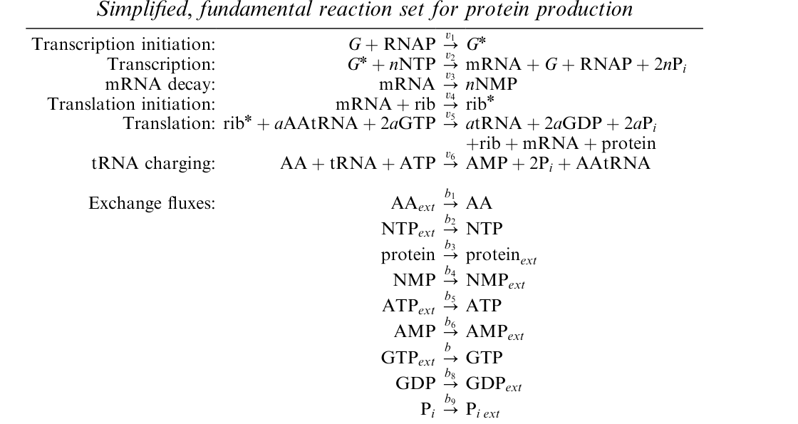
Modelling Effect of RBCS Overexpression with TXTL
For RBCS gene with 990 nucleotides and 170 amino acids:
BCS+RNAP=RBCS*
RBCS*+192*ATP+219*UTP+256*GTP+326*CTP=mRNA+RBCS+RNAP+1986*Pi
mRNA=192AMP+219UMP+256GMP+326CMP
mRNA+rib=rib*
rib*+559*AAtRNA+1118GTP=559tRNA+1118GDP+1118Pi+rib+mRNA+RBCS
AA+tRNA+ATP=AMP+2Pi+AAtRNA
559AA=559AA
192ATP=192ATP
219UTP=219UTP
256GTP=256GTP
326CTP=326CTP
RUBISCO=RUBISCO
192AMP=192AMP
256GMP=256GMP
219UMP=219UMP
326CMP=326CMP
Pi=Pi
T7RNAP+RNAP=T7RNAP*
mRNAp=12*ATP+12*GTP+9*UTP+6*CTP
mRNAp+rib=ribp*
ribp*+1207AAtRNA+2414GTP=1207tRNA+2414GDP+2414Pi+rib+mRNAP+RNAP
GtRNAP=Gt*
Gt*+12*ATP+9*UTP+12*GTP+6*CTP=tRNA+ Gt + RNAP +1986*PiPi
Gr + RNAP =Gr*
Gr*12*ATP+12*GTP+9*UTP+6*CTP=Gr+ rib + RNAP78*Pi
Allen, T. E., and Palsson, B. Ø. (2003) Sequence-based analysis of metabolic demands for protein synthesis in prokaryotes. J. Theor. Biol. 220, 1−18
Notes:
To model the effect of transcription and translation of RBCS, I adopted a simplified reaction template proposed by Allen and Palsson. I plan to incorporate the metabolites and fluxes arising from translation by conveniently updating the previously show model. However, the translation also needs to be constrained that the system doesn’t simply explode because of the new proteins thus formed.

Slide 8

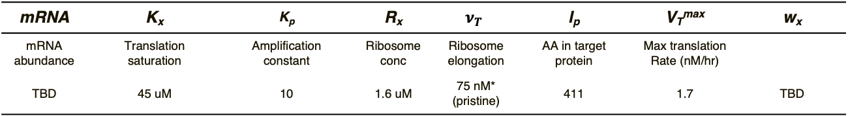
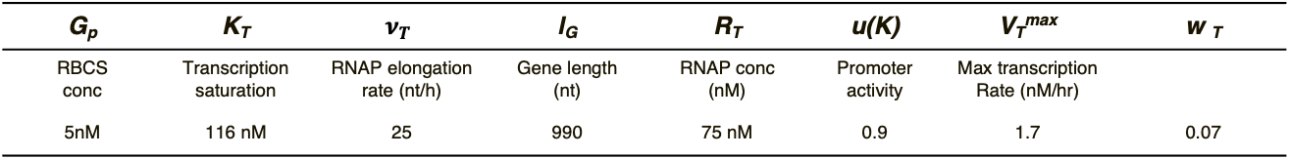
Model Equations: Transcription and Translation Constraints
Transcription rate bounds:
Subject to constraint: $L_{T}=w_{T}=U_{T}$, where: $w_{T}=V_{T}^{max}∗(\frac{G_{p}}{K_{T}+G_{p}})$.
$V_{T}^{max}=[R_{T}\left(\frac{ν_{T}}{l_{G}}\right)u\left(κ\right)]$
Translation rate bounds:
Subject to constraint: $0=w_{x}=V_{max}(\frac{mRNA}{K_{x}+mRNA})$, where: $V_{T}^{max}=[K_{P}R_{X}\left(\frac{ν_{x}}{l_{p}}\right)]$
G_{p} | K_{T} | $$ν_{T}$$ | l_{G} | R_{T} | u(K) | V_{T}^{max} | w _{T}
RBCS conc | Transcription saturation | RNAP elongation rate (nt/h) | Gene length (nt) | RNAP conc (nM) | Promoter activity | Max transcription Rate (nM/hr)
5nM | 116 nM | 25 | 990 | 75 nM | 0.9 | 1.7 | 0.07
mRNA | K_{x} | K_{p} | R_{x} | $$ν_{T}$$ | l_{p} | V_{T}^{max} | w_{x}
mRNA abundance | Translation saturation | Amplification constant | Ribosome conc | Ribosome elongation | AA in target protein | Max translation Rate (nM/hr)
TBD | 45 uM | 10 | 1.6 uM | 75 nM* (pristine) | 411 | 1.7 | TBD
M. Vilkhovoy, N. Horvath, C. Shih, J. A. Wayman, K. Calhoun, J. Swartz, D. Varner, 2018, DOI 10.1021/acssynbio.7b00465.
Notes:
Thus, I adopted transcription and translation bounds illustrated by Prof. Varner’s group to constrain the gene expression. Overexpression of RBCS is expected to improve the rubisco content by increased RNAP elongation rates and possibly higher amplification constant.

Slide 9
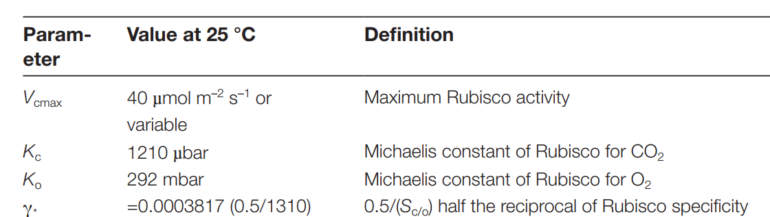
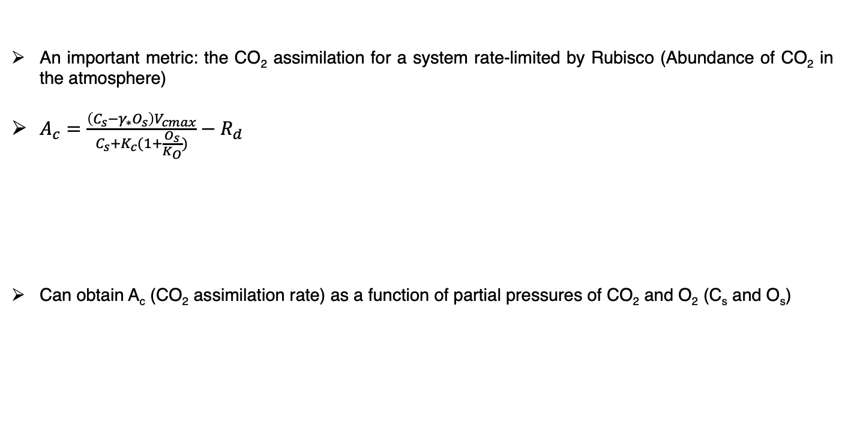
Estimating CO₂ Assimilation
An important metric: the CO₂ assimilation for a system rate-limited by Rubisco (Abundance of CO₂ in the atmosphere)
$A_{c}=\frac{\left(C_{s}−γ_{∗}O_{s}\right)V_{cmax}}{C_{s}+K_{c}(1+\frac{O_{s}}{K_{O}})}−R_{d}$
Can obtain A_{c} (CO₂ assimilation rate) as a function of partial pressures of CO₂ and O₂ (C_{s} and O_{s})
Susanne von Caemmerer, Updating the steady-state model of C₄ photosynthesis, Journal of Experimental Botany, Volume 72, Issue 17, 2 September 2021, Pages 6003–6017, https://doi.org/10.1093/jxb/erab266
Notes:
Lastly, to determine CO2 assimilation for a fixed quantity of biomass production, I adopted the following model to obtain the overall CO2 assimilation as a function of the oxygen and carbon dioxide partial pressures in the bundle sheath.

Slide 10
Moving Forward
The increased enzyme concentration for a fixed substrate concentration will be modelled using Michaelis-Menten kinetics to further constrain carboxylation;
Incorporation of TXTL with the flux balance (Previously, I used a GLPK.optimiser to solve the FBA; May need to reconsider to use simplex)
Final goal: Correlate potential relationships CO₂ assimilation/fluxes in bundle sheath with Rubisco enzyme concentrations with reported experimental results.

